Slide 1



CREDIT SCORE PREDICTION
USING MACHINE LEARNING AND DEEP LEARNING
TEAM-3

Slide 2




TEAM MEMBERS
MALVIKA
JAyanth
revanth
USHA
CHARAN
uday
MAYURI

Slide 3


OUTLINE
BACKGROUND
PROBLEM STATEMNT
DATA
METHODS AND RESULTS
CONCLUSION

Slide 4
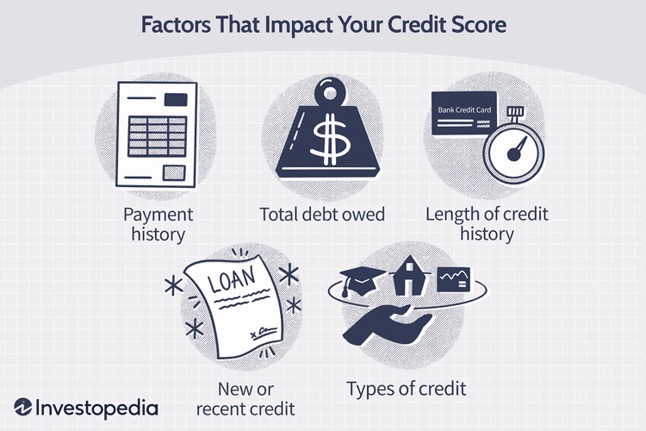
BACKGROUND
This project uses machine learning to predict credit scores based on demographic and financial features.
It enables faster, fairer, and more adaptive credit decisions compared to traditional fixed models like FICO and VantageScore.
Data-driven techniques allow for personalized credit risk assessment, improving accuracy and inclusivity.

Slide 5
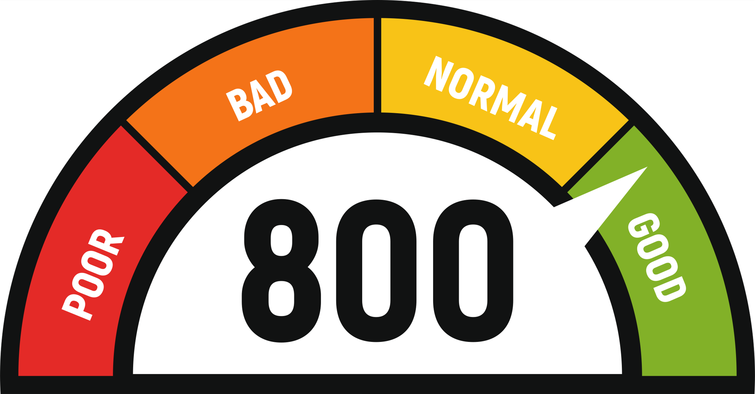


PROBLEM STATEMENT
Traditional credit scoring models struggle with capturing complex financial behaviors and adapting to evolving trends, leading to inaccurate credit assessments.
Our project leverages ML and DL to improve predictive accuracy, fairness, and interpretability

Slide 6

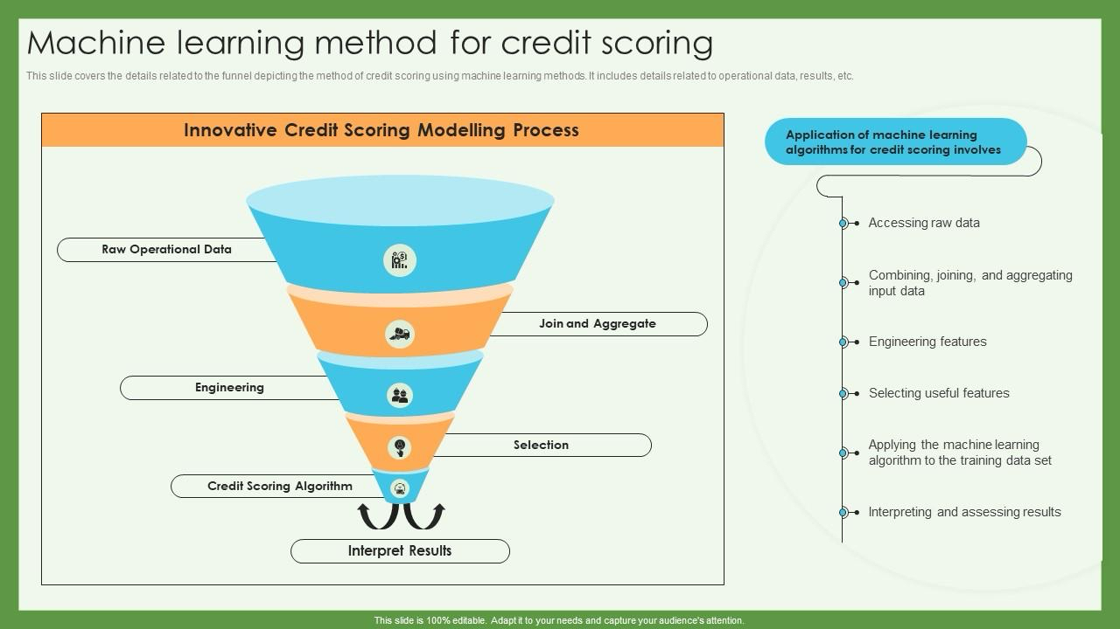
STEP 1:
Developing a Machine Learning Model for Credit Score Prediction:
1.Build a machine learning model that predicts credit scores based on various financial and behavioral factors.
2.Evaluate different ML algorithms and select the best-performing one for accurate credit risk assessment.
3.If the model’s accuracy is low, apply hyperparameter tuning techniques such as RandomizedSearchCV to optimize performance and improve predictive accuracy.
FURTHER APPROACH

Slide 7
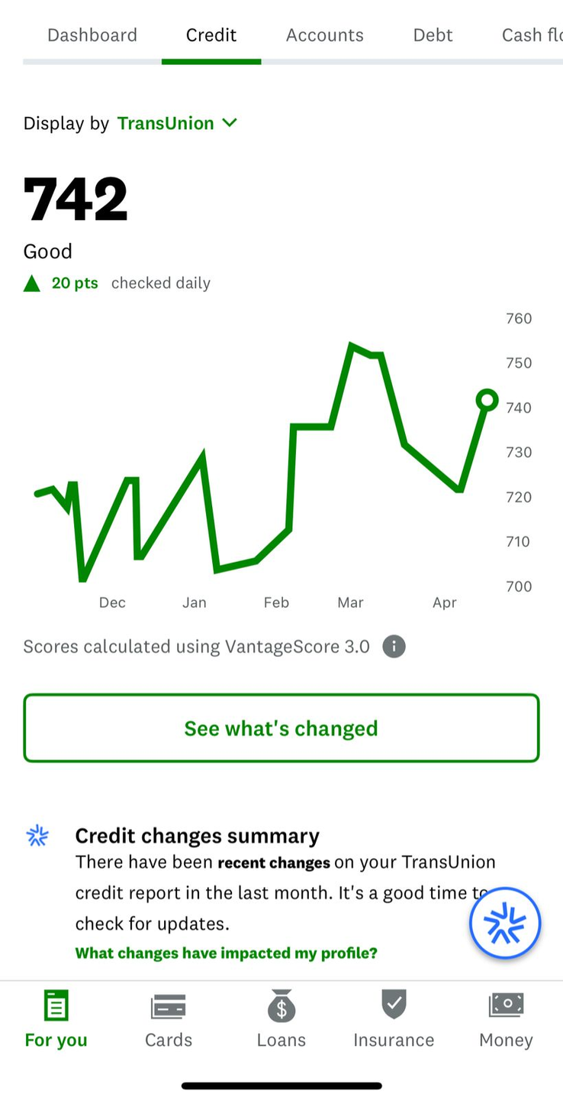
FURTHER APPROACH
STEP 2:
Model Deployment and Web-Based Application Development:
1.Once the optimized model is finalized, save it as a pickle (.pkl) file for future use.
2.Develop a web-based application that integrates the trained model, allowing users to input financial details and receive predicted credit scores.
Ensure the web app is user-friendly, interactive, and provides clear explanations of predictions using XAI techniques (e.g., flask) for transparency

Slide 8
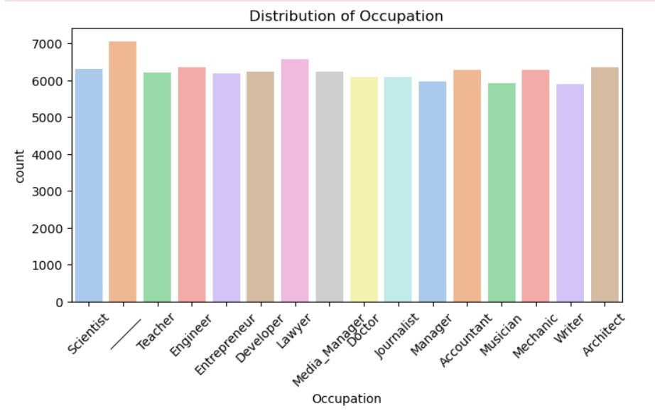
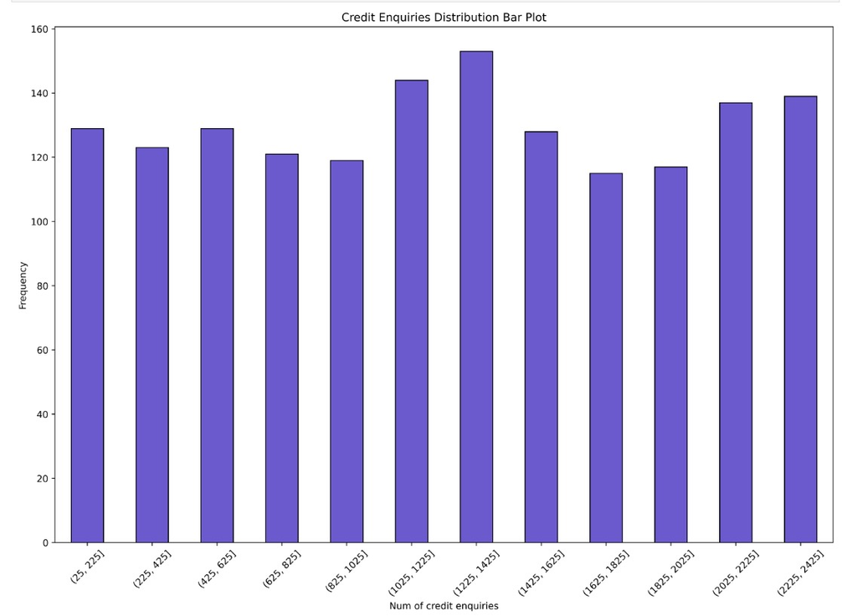
Exploratory Data ANalysis (EDA)
Representation of Distribution of occupation Vs count in the dataset
REpresentatIon of credIT enquiries distribution bar plot

Slide 9
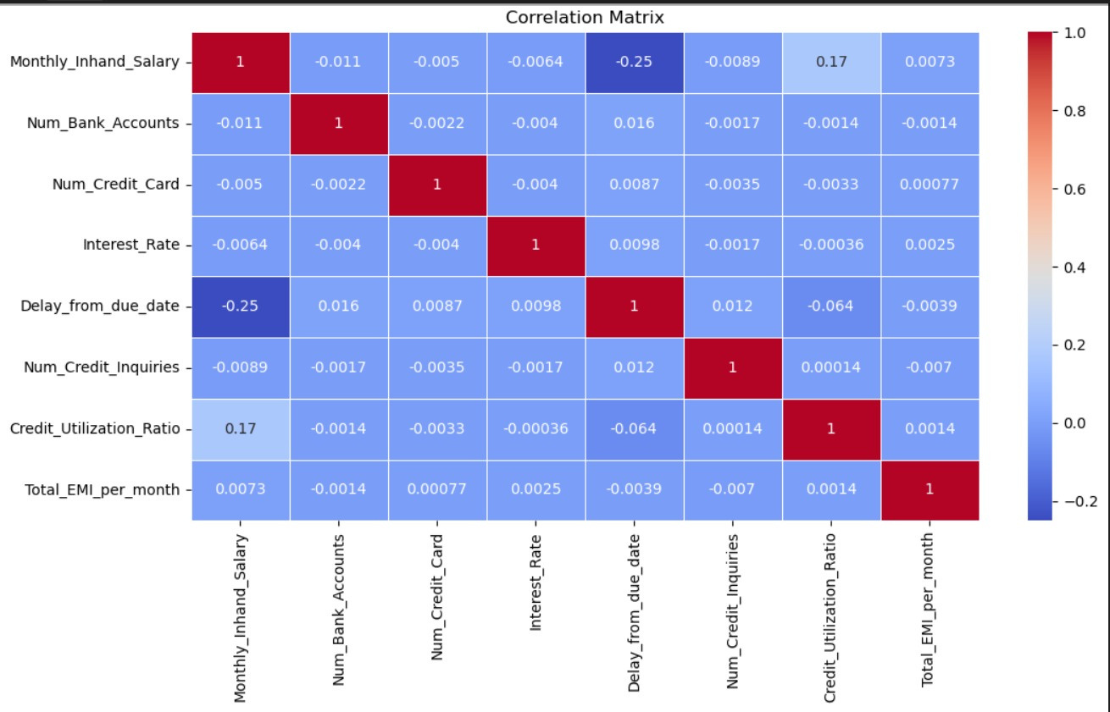
CORRELATION MATRIX BEFORE DATA CLEANING

Slide 10
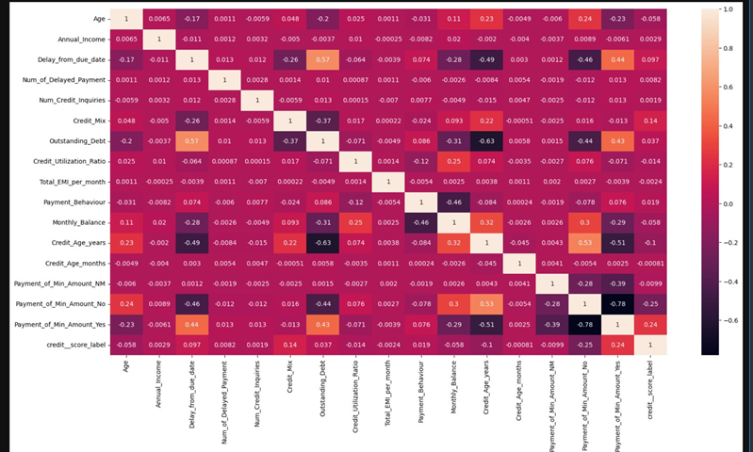
CORELATION MATRIX AFTER DATA CLEANING
Outstanding debt and delayed payments show a moderate positive correlation while credit age and the number of delayed payments are negatively correlated.

Slide 11
CHI- SQUARE TEST
RESULT
Factors Affecting Credit Score
Chi-square Statistic: Measures deviation from expected frequencies; higher values indicate stronger relationships.
•
•P-value: Probability under the null hypothesis (no relationship).
•p < 0.05 → Significant association
•p > 0.05 → No significant association
Degrees of Freedom (df): Number of independent comparisons.
Key Findings:
•Age (χ² = 5229.79, p = 0.0) → Strong impact on creditworthiness.
•Occupation (χ² = 181.1, p = 2.43e-24) → Moderate influence.
•Annual Income (χ² = 134413.15, p = 0.0) → Major factor in credit scoring.
•Delay from Due Date (χ² = 24626.21, p = 0.0) → Significant negative impact.
•Number of Delayed Payments (χ² = 20540.30, p = 0.0) → Frequent delays lower credit scores.
Conclusion
• All variables significantly impact credit scores.
• Annual Income, Delayed Payments, and Age are the strongest predictors.

Slide 12

MACHINE LEARNING MODELS
Logistic Regression - Linear model predicting class probabilities
K-Nearest Neighbour - Instance-based learning using feature similarity
Naive Bayes - Probabilistic model assuming feature independence
Decision Tree - Rule-based, interpretable model
Random Forest - Ensemble of decision trees (bagging)
SVM - Margin-based classifier effective in high dimensions
XGBoost - Fast, regularized gradient boosting
CatBoost - Boosting optimized for categorical features

Slide 13
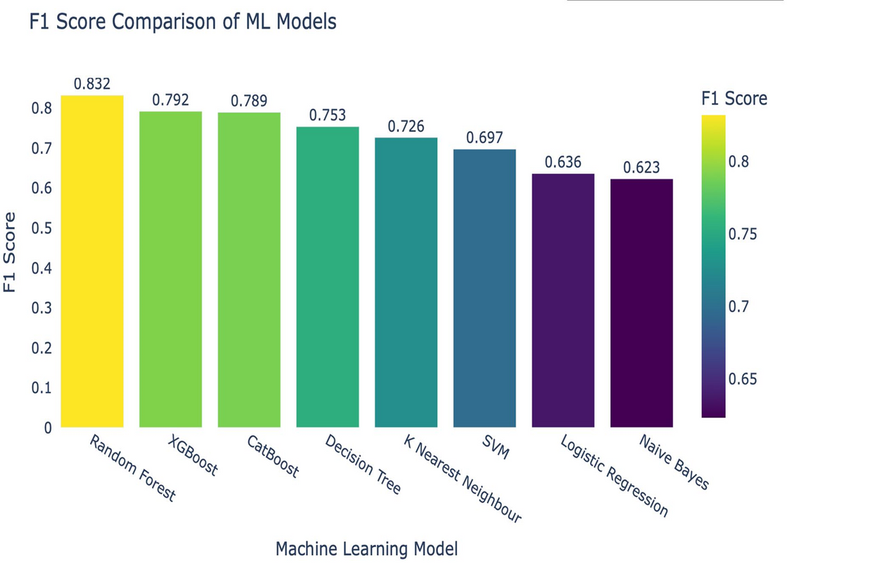
MACHINE LEARNING MODEL RESULTS:

Slide 14
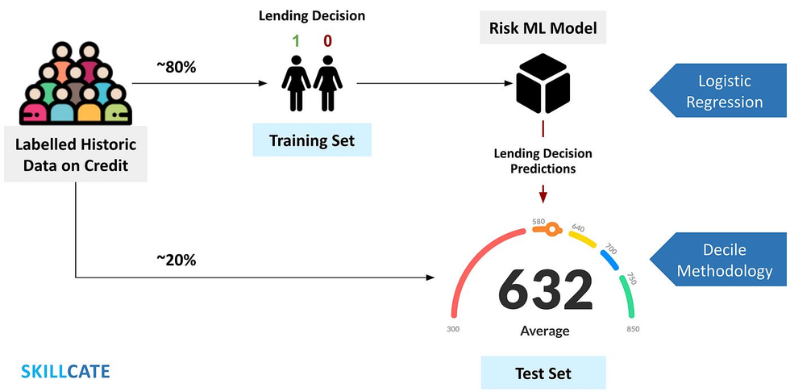
DEEP LEARNING MODELS AND TUNING PARAMETERS
Feedforward Neural Network - Multilayer dense architecture
Layers: 1286432 → Softmax output
Activation: ReLU + Dropout + BatchNormalization
Output Activation: Softmax for multiclas
Framework: TensorFlow with Keras AΡΙ
Features:
Class weight balancing
Early stopping
Feature scaling with StandardScaler

Slide 15

LINK to website
http://127.0.0.1:8000

Slide 16
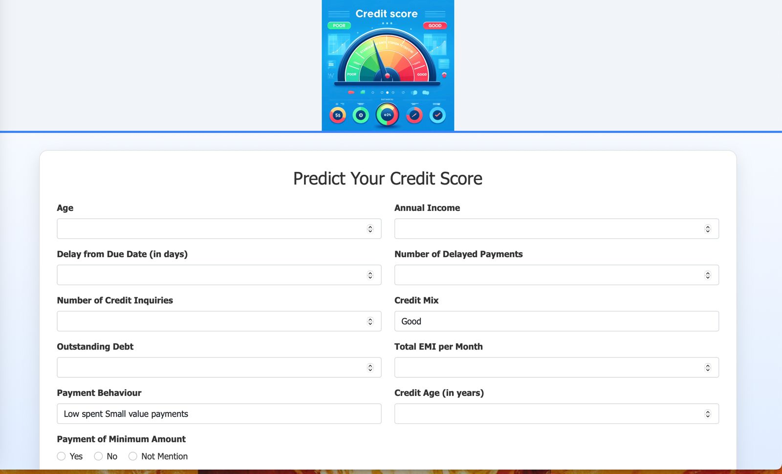

“We built a user-friendly web application using Flask, HTML, and CSS that predicts credit score categories based on user inputs such as income, debt, payment behavior, and credit history.”

Slide 17
Resource page
1. Lessmann, S., Baesens,B., Seow, H. V., & Thomas, L. C. (2015). Benchmarking state- of- the-art classification algorithms for credit scoring: An update of research. European Journal of Operational Research, 247(1), 124–136.
https://doi.org/10.1016/j.ejor.2015.05.030
2. Xia, Y., Liu, C., Li, Y., & Liu, N. (2017). A boosted decisiontree approach using Bayesian hyper-parameter optimization for credit scoring. Expert Systems with Applications, 78, 225–241.
https://doi.org/10.1016/j.eswa.2017.02.017
3. Molnar, C. (2022). Interpretable Machine Learning: A Guide for Making Black Box Models Explainable. Retrieved from
https://christophm.github.io/interpretabl e-ml-book/
4. Lundberg, S. M., & Lee, S. I. (2017). A unified approach to interpreting model predictions. In Advances in Neural Information Processing Systems (Vol. 30).
https://proceedings.neurips.cc/paper/20 17/file/8a20a8621978632d76c43dfd28 b67767- Paper.pdf
5. Ribeiro, M. T., Singh, S., & Guestrin, C. (2016). “Why should I trust you?” Explaining the predictions of any classifier. In Proceedings of the 22nd ACM SIGKDD International Conference on Knowledge Discovery and Data Mining (pp. 1135– 1144).
https://doi.org/10.1145/2939672.2939778

Slide 18


Thank you

